Slide 1
Presentation
E-commerce(shoes)
Project Management

Slide 2
Chartet
*Project name : E-commerce(shoes)
*Project sponser : Dark store
*Title : assuit _alnemas street Egypt
*the phone : 043339256
*E-mail : darkstore@gmail.com
*Project manager :mr/Mohamed Salah

Slide 3
Team
عبدالله محمد عبدالسيد حسين
عبدالرحمن زكريا سنوسي خالد

Slide 4
Description
As a result of the process of development in the Internet had to be marketing to get a share of the advantages of this so our project works on marketing (shoes) in an easy and fast way for users where they can buy and pay in several different ways to facilitate them

Slide 5
Project objective
: As a result of the process of development in the Internet had to be marketing to get a share of the advantages of this so our project works on marketing (shoes) in an easy and fast way for users where they can buy and pay in several different ways to facilitate them

Slide 6
Requirement
1-web site
2-data base
3-buy chose
4-research

Slide 7
constraints
Are anything that limited the project manager’s options Project constraints include: • Budgets: The project cost mustn’t exceed the range of 200.000$ • Deadline: The project must be done by the begin of the next year • Resources: *The system hardware devices must all be from DELL *The system software licenses must be accredited from Oracle *Servers must upload the database on the cloud

Slide 8
Project Assumptions
1-every person can find us in neternet
2-No one will leave the team
3-the payement will be in cash only
4- no showing product not exsit in the campny

Slide 9
WBS
1.1 Initiation
1.2-Software &Hard ware
1.2.1 Install
1.2.2 Design
1.2.3 Implement
1.3- test web
1.3.1-unit test
1.3.2-system test
1.4- Close

Slide 10
Budget
ID | DUR | TASKS | Budget
1.1 | 7 | Initiation | 40,000$
1.2.1 | 1 | Soft &hard ware install | 20,000
1.2.2 | 2 | soft& hard ware design | 45,000
1.2.3 | 3 | soft& hard ware implement | 40,000
1.3.1 | 3 | test we unit | 30,000
1.3.2 | 2 | test web system | 15,000
1.4 | 2 | feed& deliver &report | 10,000

Slide 11
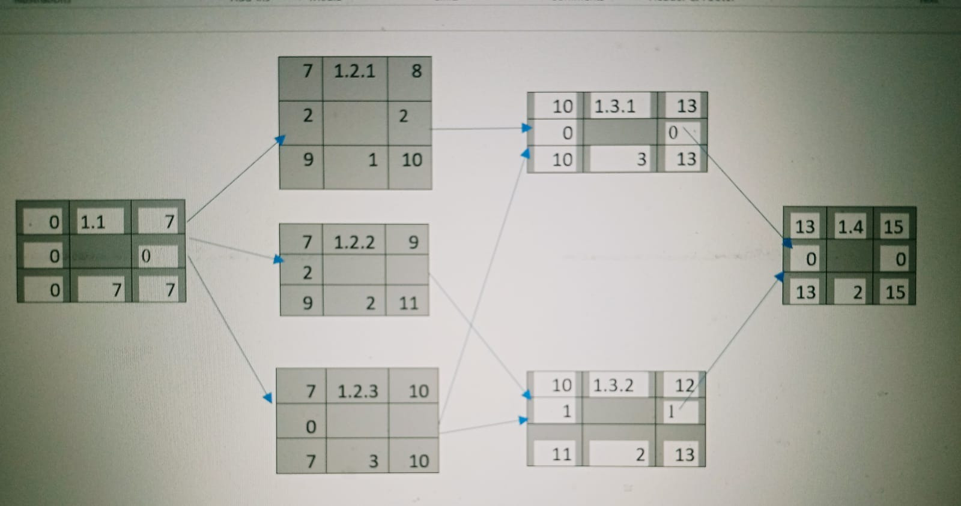
Net Work

Slide 12
Baseline Budget
0 1 2 3 4 5 6 7 8 9 10 11 12 13 14 15
ID | Budget
1.1 | 40,000$ | 6,000 | 6,000 | 6,000 | 2,000 | 6,000 | 7,000 | 7,000
1.2.1 | 20,000$ |  |  |  |  |  |  |  | 20,000
1.2.2 | 45,000$ |  |  |  |  |  |  |  | 25,000 | 20,000
1.2.3 | 40,000$ |  |  |  |  |  |  |  | 9,000 | 20,000 | 11,000
1.3.1 | 30,000$ |  |  |  |  |  |  |  |  |  |  | 5,000 | 15,000 | 10,000
1.3.2 | 15,000$ |  |  |  |  |  |  |  |  |  |  | 7,000 | 8,000
1.4 | 10,000 |  |  |  |  |  |  |  |  |  |  |  |  |  | 5,000 | 5,000
Total | 200,000$ | 6,000 | 6,000 | 6,000 | 2,000 | 6,000 | 7,000 | 7,000 | 54,000 | 40,000 | 11,000 | 12,000 | 23,000 | 10,000 | 5,000 | 5,000
Commutative |  | 6,000 | 12,000 | 18,000 | 20,000 | 26,000 | 33,000 | 40,000 | 94,000 | 134,000 | 145,000 | 157,000 | 180,000 | 190,000 | 195,000 | 200,000

Slide 13
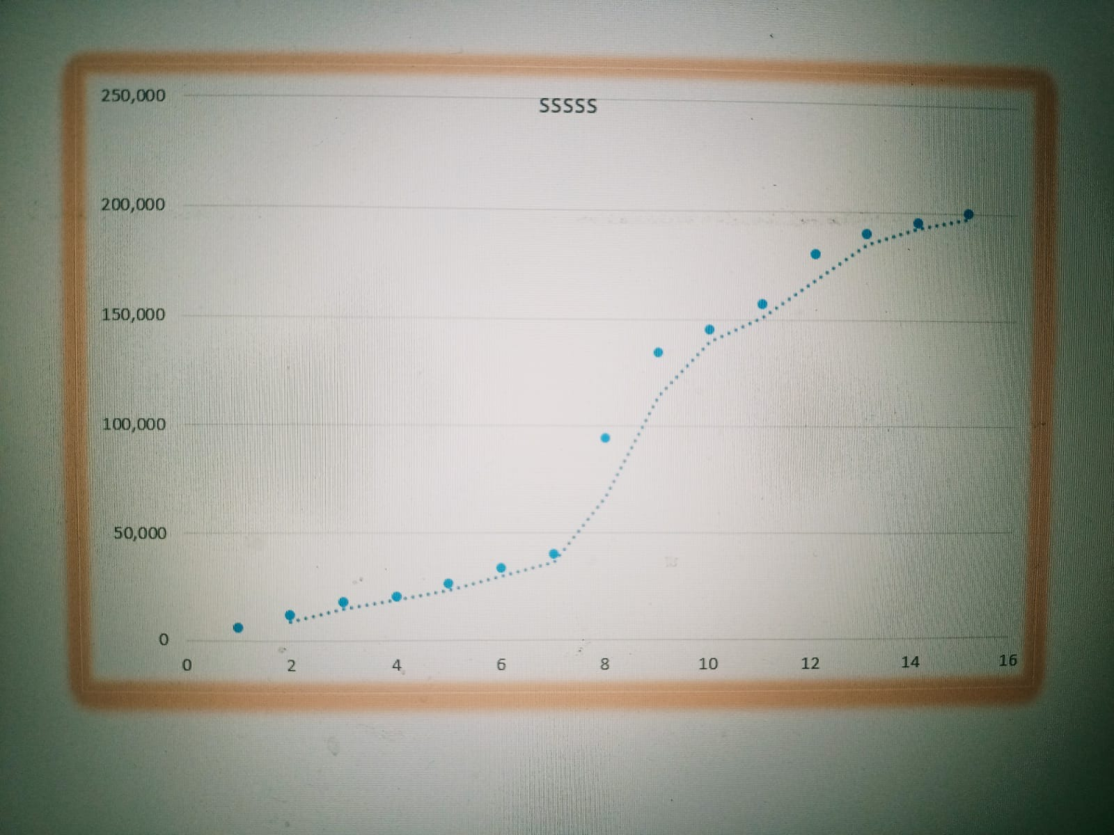
Time phase

Slide 14
Responsibility Matrix Responsibility of each team
Responsibility Matrix
Responsibility of each team
Tasks | Abdullah | Abdulrahman
Initiation | S | R
soft& hard ware install | S | R
soft& hard ware design | R | S
soft& hard ware implement | R | S
test we unit | S | R
test web system | R | S
feed&deliver&report | S | R
Responsibility | R
Supportive | S

Slide 15
Resource
0 1 2 3 4 5 6 7 8 9 10 11 12 13 14 15
ID | RES | DUR | ES | LF | SL
1.1 | 2p | 7 | 0 | 7 | 0 | 2 | 2 | 2 | 2 | 2 | 2 | 2
1.2.1 | 2p | 1 | 7 | 10 | 2 |  |  |  |  |  |  |  | 2
1.2.2 | 2p | 2 | 7 | 11 | 2 |  |  |  |  |  |  |  | 2 | 2
1.2.3 | 1p | 3 | 7 | 10 | 0 |  |  |  |  |  |  |  | 1 | 1 | 1
1.3.1 | 1p | 3 | 10 | 13 | 0 |  |  |  |  |  |  |  |  |  |  | 1 | 1 |  | 1
1.3.2 | 1p | 2 | 10 | 13 | 1 |  |  |  |  |  |  |  |  |  |  | 1 | 1
1.4 | 1p | 2 | 13 | 15 | 0 |  |  |  |  |  |  |  |  |  |  |  |  |  |  |  | 1 |  | 1
Total Resource Load |  |  |  |  |  | 2p | 2p | 2p | 2p | 2p | 2p | 2p | 5p | 3p | 1p | 2p |  | 2p |  | 1p |  | 1p | 1p
Resource Available |  |  |  |  |  | 5p | 5p | 5p | 5p | 5p | 5p | 5p | 5p | 5p | 5p | 5p |  | 5p |  | 5p |  | 5p | 5p

Slide 16
Risks
1-system break down
2- customer information steel
3-customer enter a wrong info
4-one of team leaves
5- financial viability
6- System Reliability

